Slide 1
Repairing Standard
Scottish Government Guidance
PROVISION FOR DETECTING AND WARNING OF FIRES

Slide 2
PROVISION FOR DETECTING AND WARNING OF FIRES
When the Repairing Standard was introduced (3 September 2007) there was a transitional arrangement that allowed existing battery powered smoke detectors to be used for the remainder of their existing life.
Any replacement detector after that date had to have hard wired fire alarms.
However, all existing let property occupying more than one floor had to have hard wired and interlinked fire alarms.

Slide 3
PROVISION FOR DETECTING AND WARNING OF FIRES
The Repairing Standard sets a high benchmark for smoke and fire detection, matching the standard required for new building and which is higher than many owner-occupiers will meet for their own homes.
Now that any battery powered smoke detector in use in September 2007 should have reached the end of its life, all detectors should now be hard wired and interlinked.

Slide 4
PROVISION FOR DETECTING AND WARNING OF FIRES
Scottish Government Guidance
All privately rented homes should, if at all possible, meet this standard. However, the most important thing is that there should be some provision to detect fires and that this should be operational and in good working order. Landlords are entitled to rely on professional advice from qualified electricians on their compliance with the standards in building regulations.

Slide 5
PROVISION FOR DETECTING AND WARNING OF FIRES
Scottish Government Guidance
There should now be at least:
• one functioning smoke alarm in the room which is frequently used by the occupants for general daytime living purposes,
• one functioning smoke alarm in every circulation space, such as hallways and landings,
• one heat alarm in every kitchen, and
• all alarms should be interlinked.

Slide 6
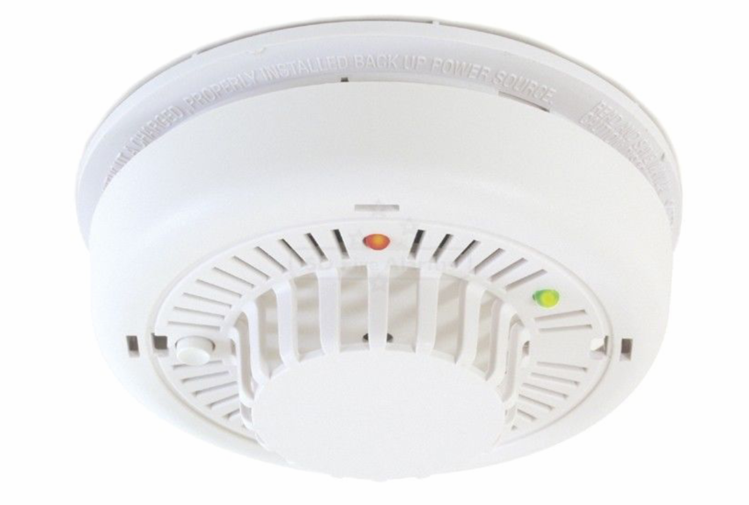
PROVISION FOR DETECTING AND WARNING OF FIRES
Heat alarm

Slide 7
PROVISION FOR DETECTING AND WARNING OF FIRES
Scottish Government Guidance
Landlords may be able to justify why a lesser level of protection is appropriate in a particular home such as:-
Where the proximity of an open fireplace would make a detector
impracticable,
Where the cost of installing detectors would be prohibitive,
Where the landlord intends to install detectors within a reasonable timescale as part of a programme of upgrading a property.

Slide 8
PROVISION FOR DETECTING AND WARNING OF FIRES
Scottish Government Guidance
If there is a requirement for the house to meet a more stringent standard of provision for detecting and giving warning of fire (for example, in a house in multiple occupation (HMO) requiring to be licensed, or under building regulations), then the higher standard must be met.
The fitting of a hardwired smoke/heat alarm system may require a building warrant and landlords should consult the Building
Standards department of the local authority.

